Slide 1
Prediction of Chronic Kidney Diseases using Deep Artificial Neural Network Technique
Presented By:
Himanshu Kriplani
Student, Department of Computer Science,
Ganpat University
Authors: Himanshu Kriplani, Bhumi Patel, Sudipta Roy
Conference : International Conference on Clinical and Medical Image Analysis

Slide 2
Contents:
Abstract
Introduction
Methodology
Conclusion

Slide 3
Abstract
The progression of the chronic kidney disease and methodologies to diagnose chronic kidney disease is a challenging problem which can reduce the cost of treatment.
We studied 224 records of chronic kidney disease available on the UCI machine learning repository named chronic kidney diseases dating back to 2015. Our proposed method based on deep neural network which predicts the presence or absence of chronic kidney disease with an accuracy of 97%.
This automatic chronic kidney disease detection helps reduce the kidney damage progression, but for this chronic kidney disease detection at initial stage is necessary.

Slide 4
Introduction
In the United States(US), about 117,000 patients developed end stage renal disease (ESRD) requiring dialysis, while more than 663,000 prevalent patients were on dialysis in 2013. In 2012, total Medicare spending for ESRD was about $28 billion representing 5.6% of the entire Medicare budget.
In India the approximate prevalence of chronic kidney disease is 800 per million populations (pmp), and the incidence of end-stage renal disease (ESRD) is 150-200 pmp.

Slide 5

Neural Network
We have used Input Layer, hidden Layer and Output Layer.
Activation Function used to activate the layer on the basis of weight.
Activation Function used:
Relu for Layer 2 (Hidden Layer)
Relu has a range of [0,1] and it returns max(0,x)
Sigmoid for Layer 3(Output layer)
Its returns 0 or 1.
Notes:
Multiple hidden layer can be used depending on the need. We have used only 1 hidden layer.

Slide 6
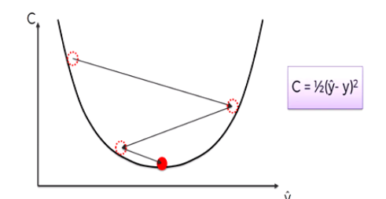
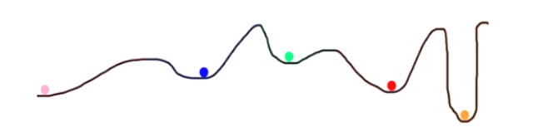
Gradient Descent Stochastic Gradient Descent

Slide 7
Neural Network (Cont.)
Our data set has 18 parameters, thus the input layer has 18 perceptron with relu as a activation function.
In the hidden layer we have taken 9 perceptron.
The last layer has a single perceptron which is activated using sigmoid function thus resulting in 0 or 1 as the classification of chronic kidney disease.

Slide 8
K-Fold Cross Validation
We have used K-fold cross validation with k=10.
For classification, the accuracy estimate is the overall number of correct classifications from the k iterations, divided by the total number of tuples i.e. 224 tuples

Slide 9
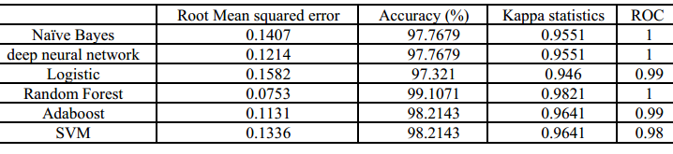
Results

Slide 10
Conclusion
We trained a neural network model to predict presence of chronic kidney disease. It may result more accurate predictions if more data is used. Clinics and hospitals can use this for faster and digitized methodology for prediction of chronic kidney disease. All other models compared, deep neural network has showed it worth in predicting the chronic kidney disease. The results would be more promising with increase in dataset.

Slide 11
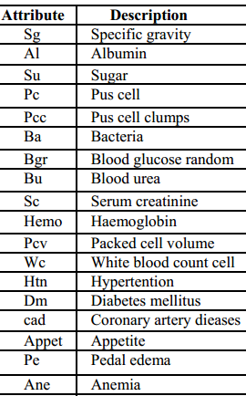
Appendix

Slide 12
Thank you.

